Slide 1
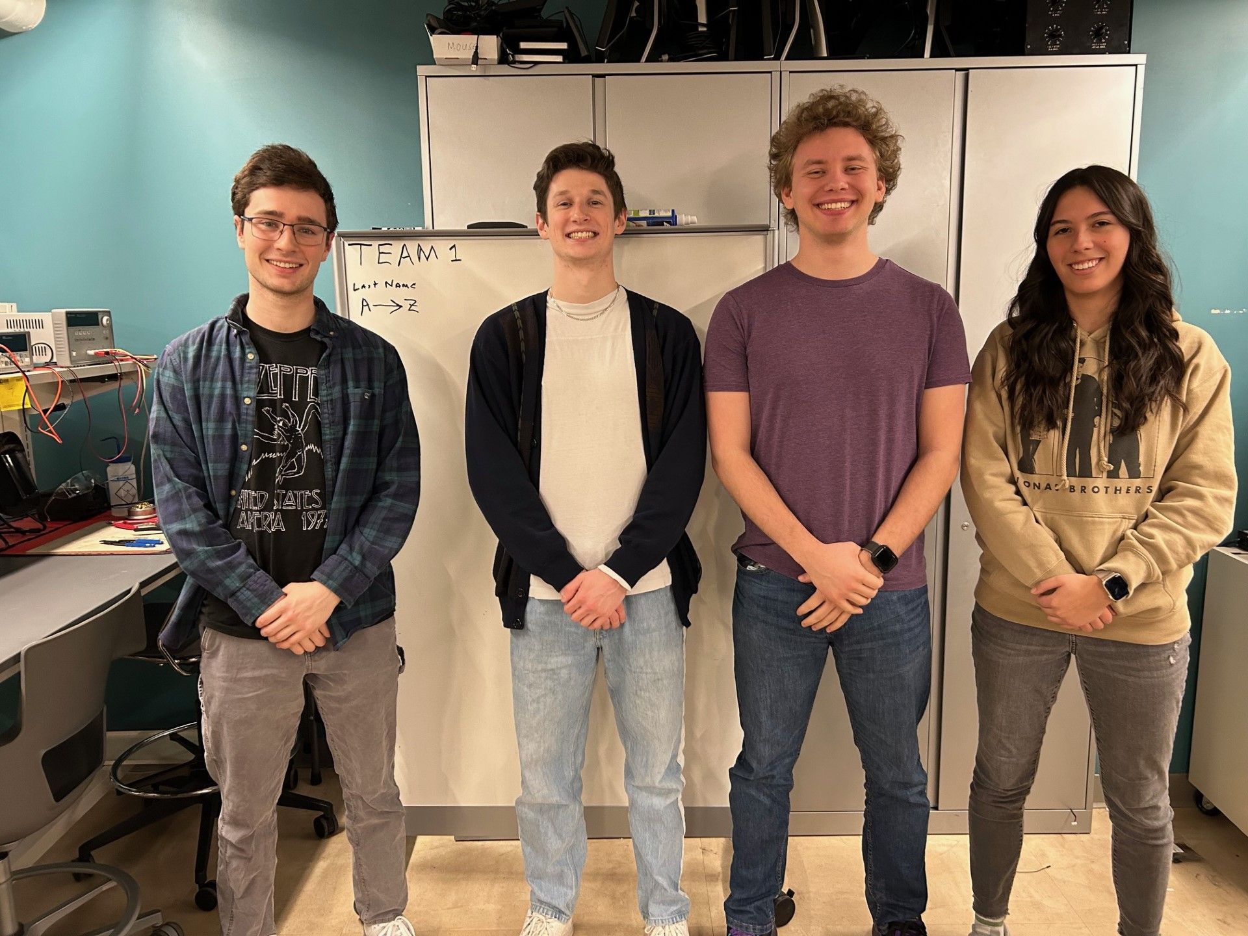
ECE477 Midterm Design Review: Team 1
Notes:
During the presentation make sure to introduce yourselves and identify your team roles.
Presentation Example 1: https://purdue.brightspace.com/d2l/le/dropbox/949519/947637/DownloadAttachment?fid=35974214
Presentation Example 2: https://purdue.brightspace.com/d2l/le/dropbox/949519/947637/DownloadAttachment?fid=35974216

Slide 2
Outline
Project Overview
Major Components
Block Diagram
Packaging Design
Electrical Schematic (Microcontroller and Hardware)
PCB Layout (Microcontroller and Hardware)
Electrical Schematic (LED and Hall Effect System)
PCB Layout (LED and Hall Effect System)
Prototyping Progress
Software Development Status
Project Timeline
Questions
Notes:
Grace

Slide 3
Project Overview
DUNgeon crawler board
An interactive game board that uses LEDs and Hall Effect (magnetic) sensors to simulate dungeon crawling games
Keeps user control and creativity but does the game calculations and character tracking automatically
Allows for user map building using a custom computer application sent to the game board through USB
Acts as a D&D "gaming console" for small groups
Notes:
Grace

Slide 4
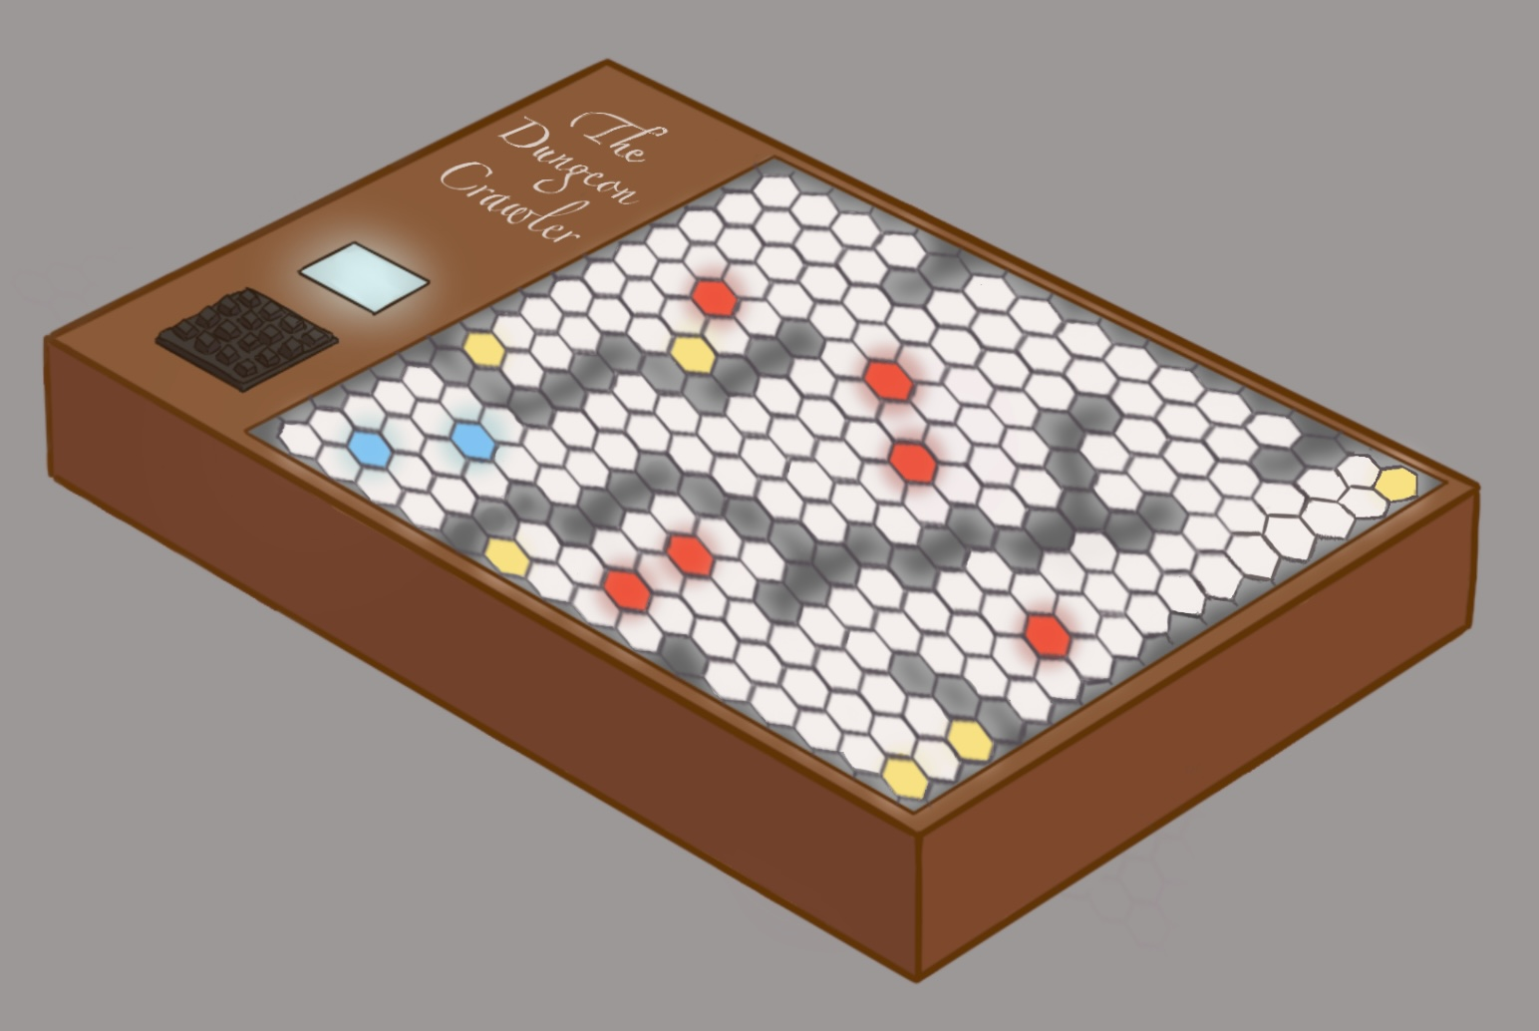
Project Overview
DUNgeon crawler board
LCD
Input Keypad
Hex Map
Notes:
Grace

Slide 5
PSDRs
Main PSDRS and Stretch PSDRs
PSDR #1 (Software): An ability to simulate a turn-based combat game involving pathing algorithms and object-oriented class systems.
PSDR #2 (Software): An ability to customize maps and characters on a computer via a Unity-based application.
PSDR #3 (Hardware): An ability to control rows of LED strips with DMA and PWM on microcontroller GPIO pins.
PSDR #4 (Hardware): An ability to control an array of Hall Effect sensors with I2C I/O expanders on a microcontroller.
PSDR #5 (Hardware): An ability to port information from a computer to a microcontroller via USB OTG.
Extra PSDR #1 (Hardware): An ability to store multiple preloaded maps on an SD card using SPI.
Extra PSDR #2 (Software): An ability to simulate ranged combat using line of sight algorithms, expanding the object-oriented class systems.
Notes:
List your team’s PSDRs in this section. This slide is intended to be used for reviewer reference only, and should be passed over quickly during the actual presentation (as there are more important things to be discussed) Grace

Slide 6
Major Components
Contents
Microcontroller
Hall Effect Sensors
I2C IO Expanders
LEDs
LCD
Keypad
Micro SD Reader
Buck Converter
Notes:
Grace – I2C IO for Hall Effects

Slide 7
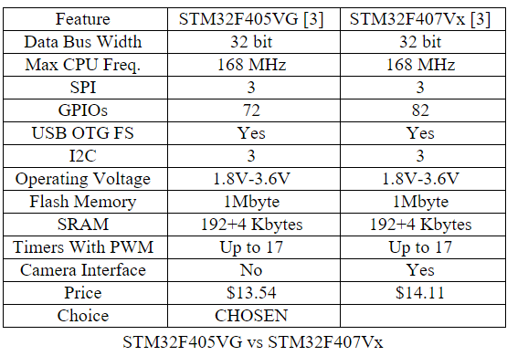
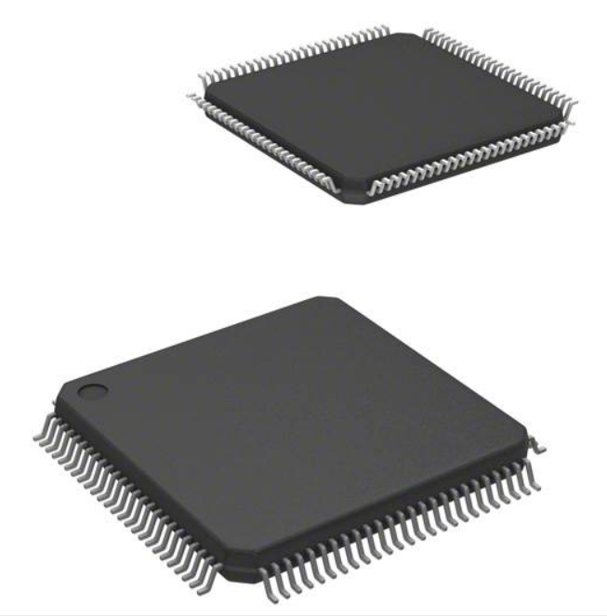
Major Components
Microcontroller selection
SELECTED: STM32F405VG
Notes:
Neil

Slide 8
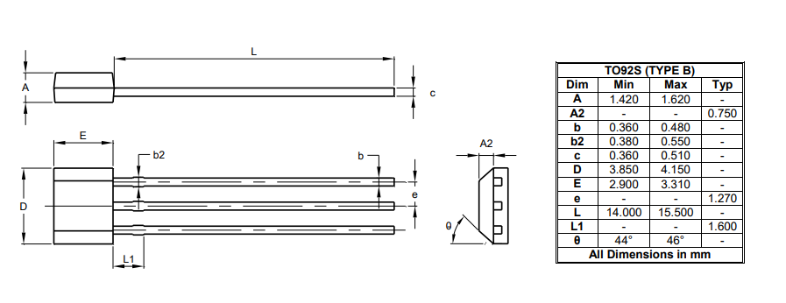
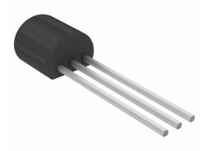
Major Components
Hall Effect sensors
Selected: AH9246-P-B
Digital
Operating Voltage: 2.5-5V
Average supply current: 8 µA
Alternative: SS49E
Analog
Operating Voltage: 4.5-6V
Average supply current: 4.2 mA
Notes:
Landon

Slide 9
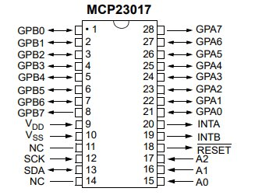
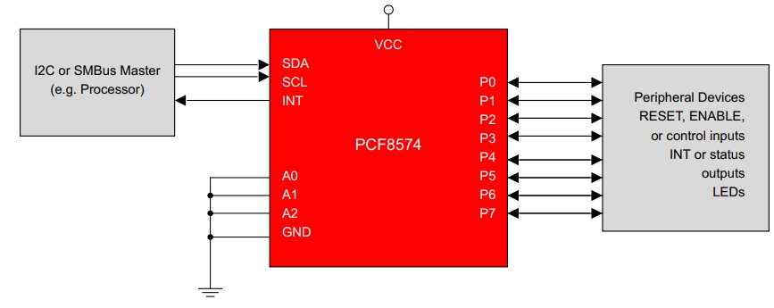
Major Components
I2c IO Expanders
Selected: MCP23017
Operating Voltage: 2.8-5.5V
Low standby current: 1 µA max
16 bit remote Bidirectional I/O pins
Alternative: PCF8574
Operating supply voltage: 2.5-6V
Low standby current: 10 µA max
8 bit remote Bidirectional I/O pins
Notes:
Landon

Slide 10
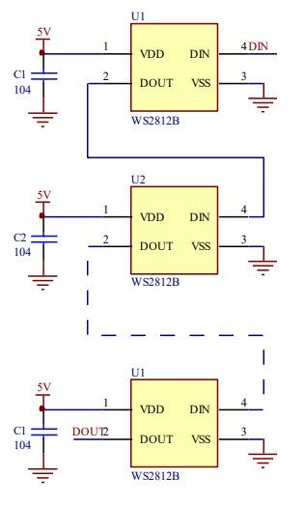
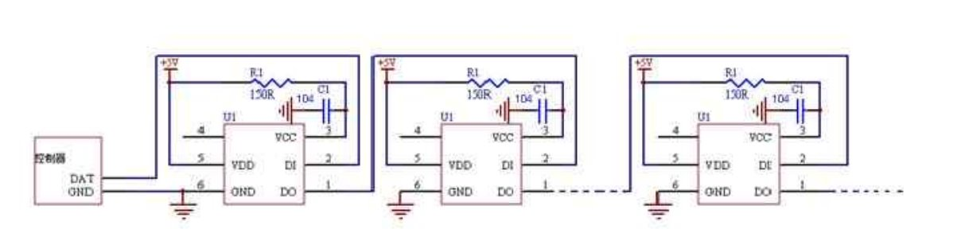
Major Components
LEDS
Selected: WS2812B
16 pins needed with PWM control
60mA max brightness all colors
Simple circuit design
Alternative: LED lamps
32 pins needed
60mA max brightness all colors
Matrix circuit design
Alternative 2: WS2812
Same specs as WS2812B but more complicated circuit design
Notes:
Landon

Slide 11
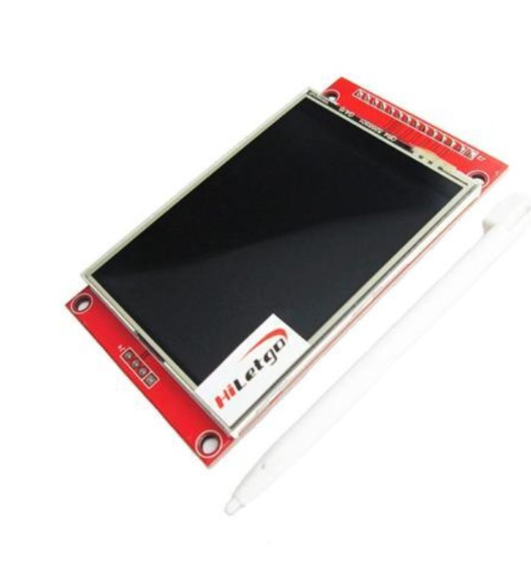
Major Components
LCD SCREEN
Selected: ILI9341
Average voltage: 1.65-3.3V
Average current: 1μA
Protocol: SPI
Size: 2.2 in
Resolution: 240x320
Alternative: CFAF320480C7-035TN
Average voltage: 1.65-3.3V
Average current: 8mA
Protocol: SPI
Size: 2.2 in
Resolution: 240x320
Notes:
Jackson

Slide 12
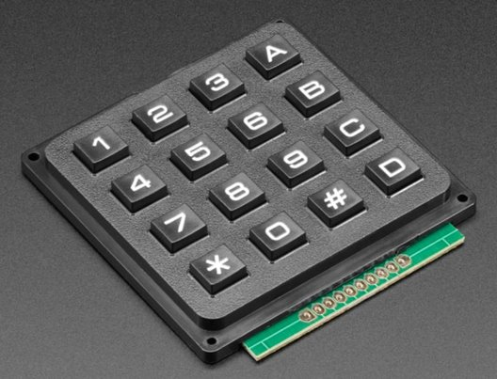
Major Components
Keypad
Selected: Adafruit Standard 4x4
Max Voltage: 24V
Price: $5.95
Buttons: 16
GPIO Pins: 8
Alternative: Parallax Membrane 4x4
Max Voltage: 24V
Price: $9.95
Buttons: 16
GPIO Pins: 8
Notes:
Jackson

Slide 13
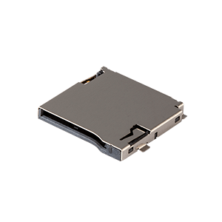
Major Components
Micro SD Reader
Selected: MSD 1-A
Max Voltage: 30V
Current: 0.5A
Pins: 9
Price: $0.23
SD 2.0
Alternative: MSD4-1-A
Max Voltage: 30V
Current: 0.5A
Pins: 9
Price: $2.50
SD 4.0
Notes:
Grace

Slide 14
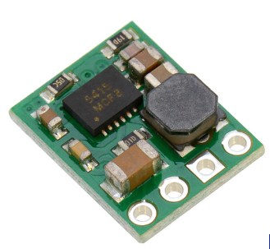
Major Components
Buck converter
Selected: Pololu 3.3V, 500mA Step-Down Voltage Regulator
Voltage Range: 3.4V - 36V
Pins: 4
Output Current: 500mA
Price: $5.95
Alternative: AMS1117-3.3 DC 4.75V-12V to 3.3V Voltage Regulator
Voltage Range: 4.75V-12V
Pins: 3
Output Current: 800mA
Price: $6.99
Notes:
Neil

Slide 15
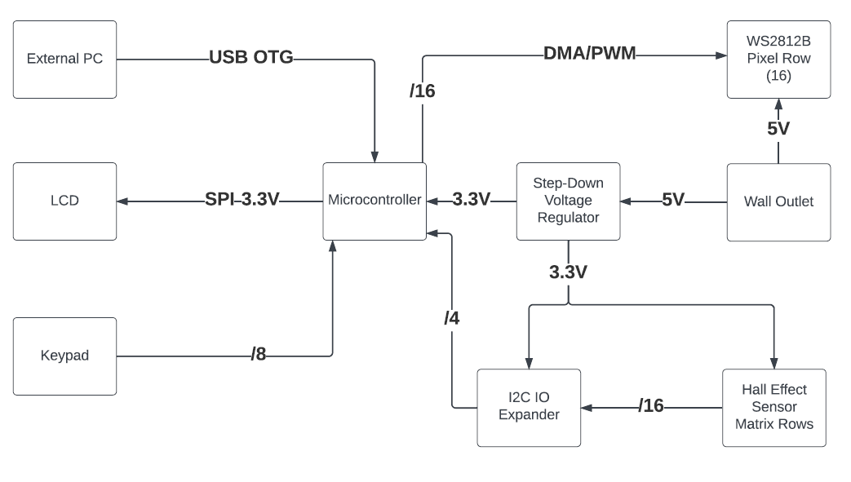
Block Diagram
Electrical Diagram
Notes:
Neil

Slide 16
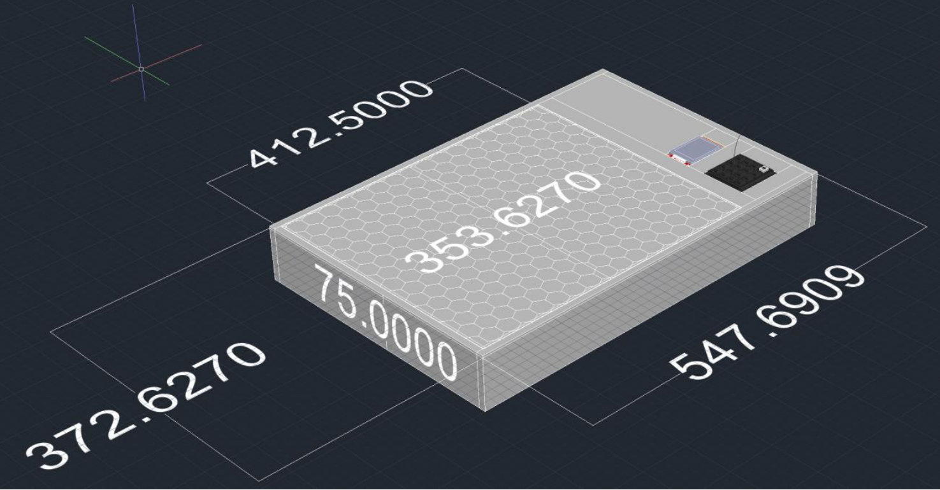
Packaging Design
Board Design
Notes:
Jackson

Slide 17
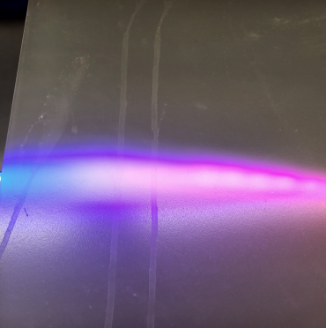
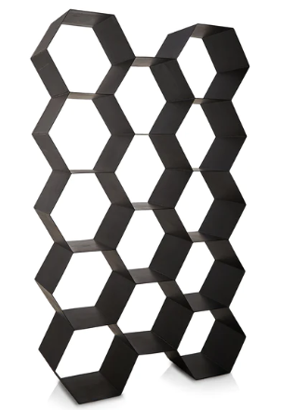
Packaging Design
Board Design - Materials
Notes:
Jackson

Slide 18
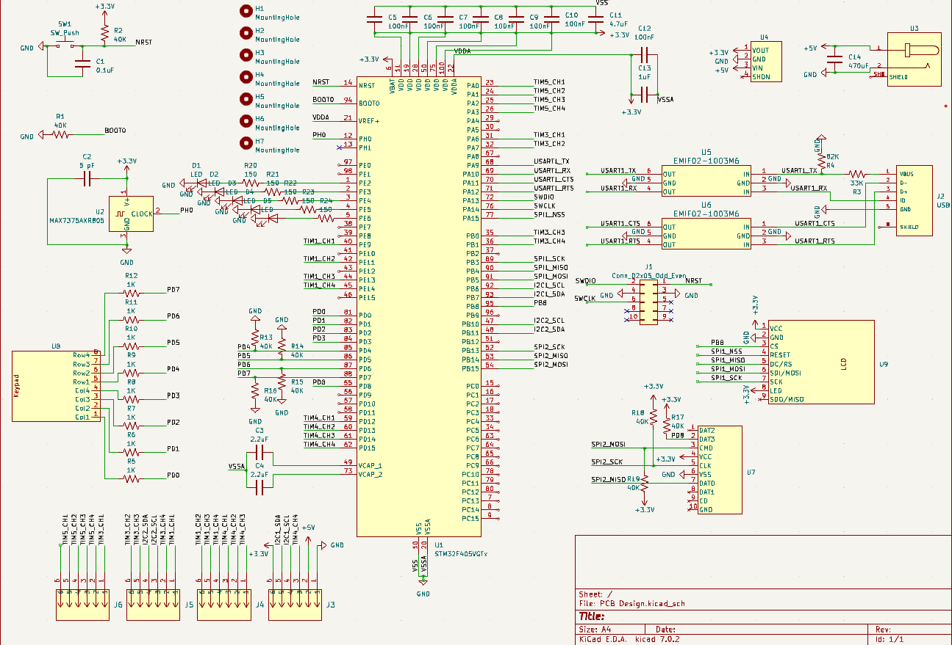
Electrical Schematic
MICROCONTROLLER AND Hardware
Notes:
Jackson

Slide 19
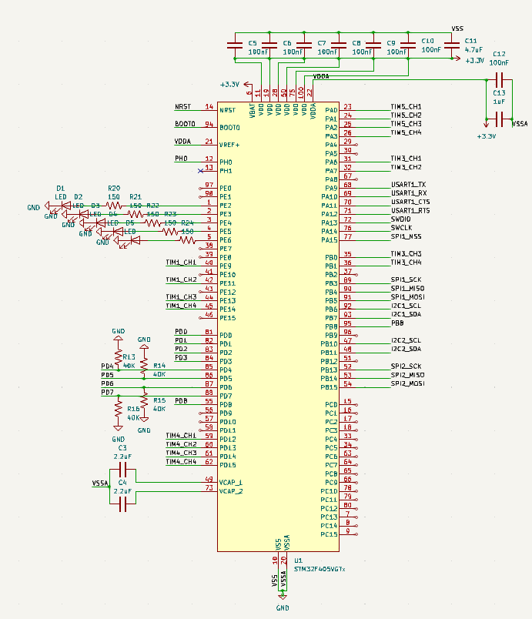
Electrical Schematic
Microcontroller
Notes:
Jackson

Slide 20
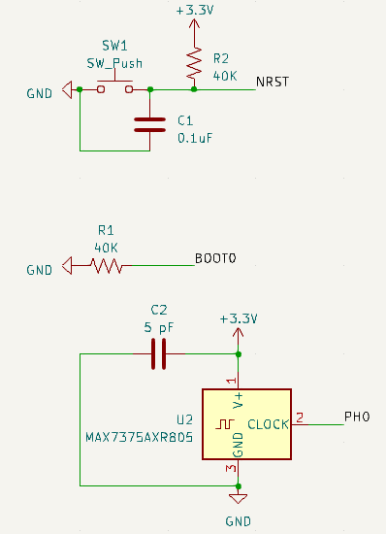
Electrical Schematic
Reset, Boot, and Clock
Notes:
Jackson

Slide 21
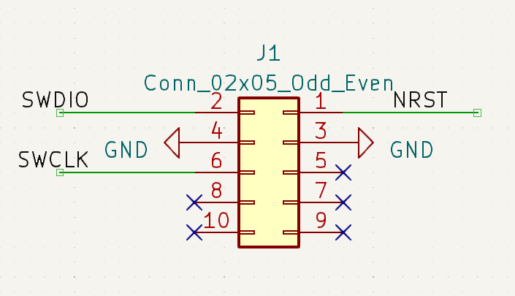
ElectRical Schematic
ST-Link
Notes:
Jackson

Slide 22
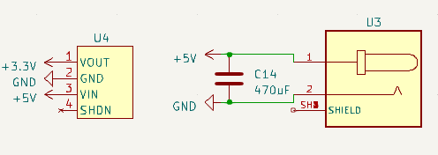
ELectrical Schematic
Power
Notes:
Jackson

Slide 23
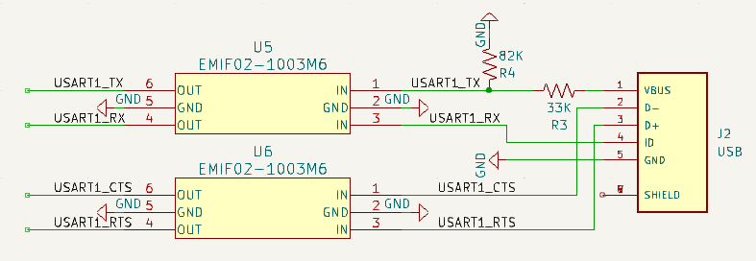
Electrical Schematic
USB
Notes:
Jackson

Slide 24
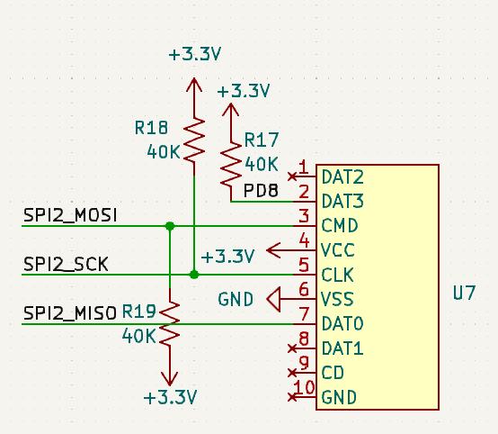
Electrical Schematic
Micro SD Reader
Notes:
Jackson

Slide 25
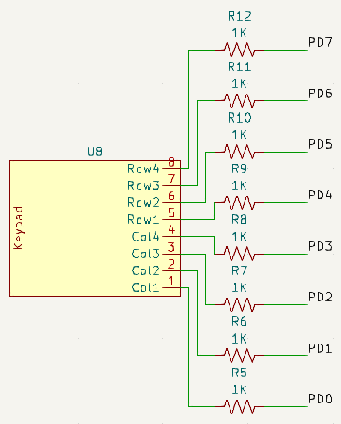
Electrical Schematic
Keypad
Notes:
Jackson

Slide 26
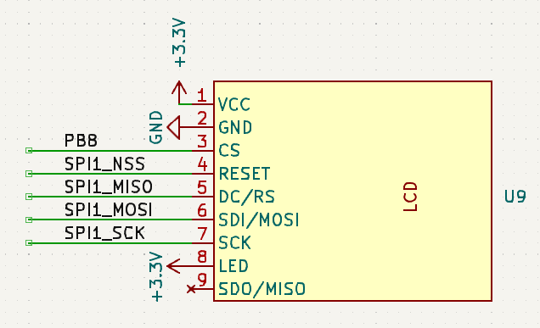
Electrical Schematic
LCD
Notes:
Jackson

Slide 27
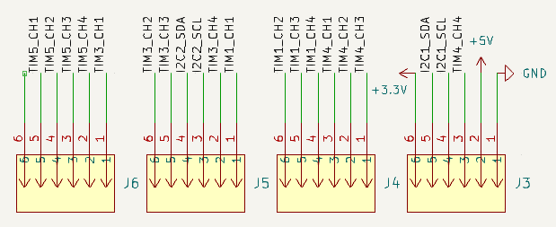
Electrical Schematic
Connectors to Hex Array PCBs
Notes:
Jackson

Slide 28
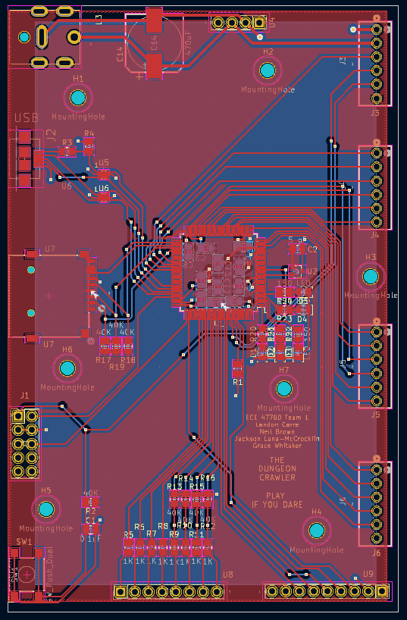
PCB Layout
Microcontroller and Hardware
Length: 112 mm
Width: 72 mm
Notes:
Jackson

Slide 29
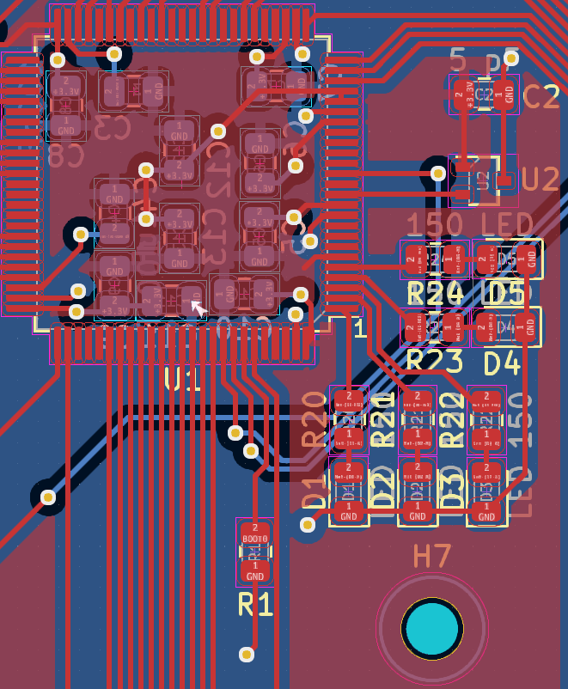
PCB Layout
Microcontroller
Notes:
Jackson

Slide 30
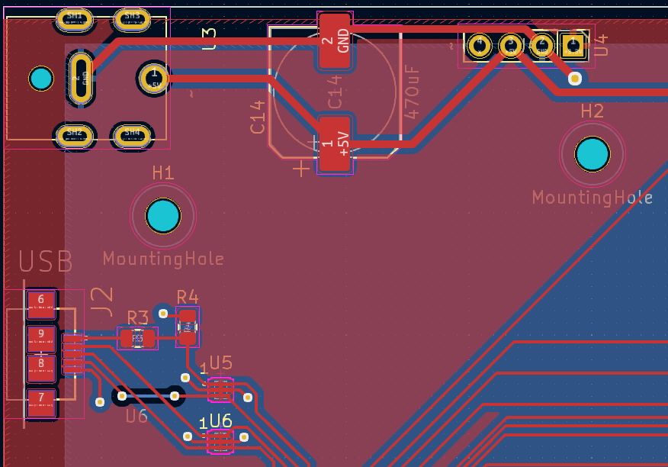
PCB Layout
Power and USB
Notes:
Jackson

Slide 31
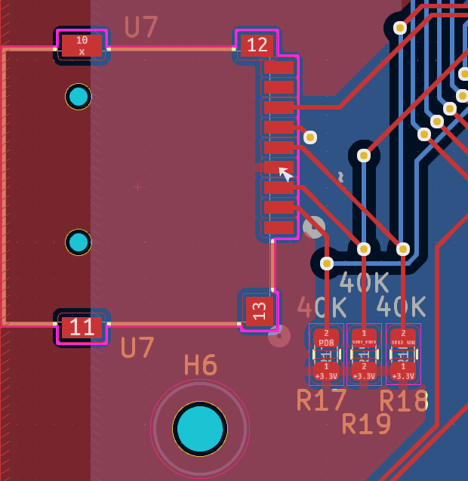
PCB Layout
Micro SD Reader
Notes:
Jackson

Slide 32
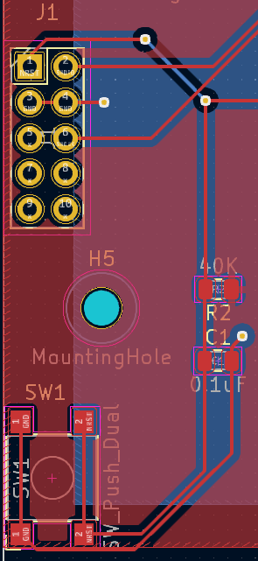
PCB Layout
ST-Link and Reset
Notes:
Jackson

Slide 33
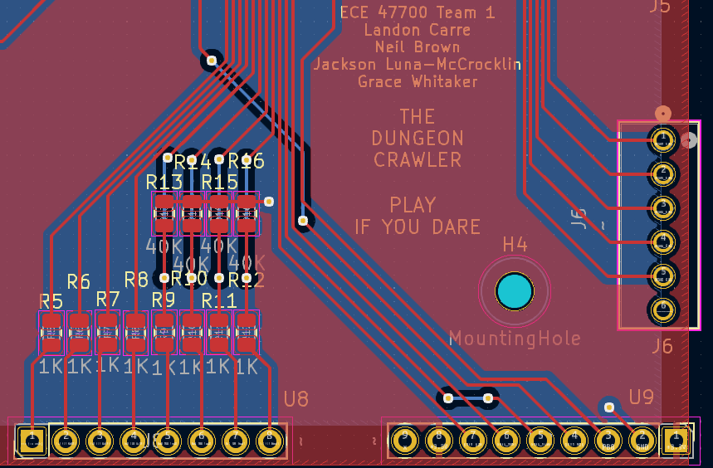
PCB Layout
Keypad, LCD, and Connector to Hex Array PCBs
Notes:
Jackson

Slide 34
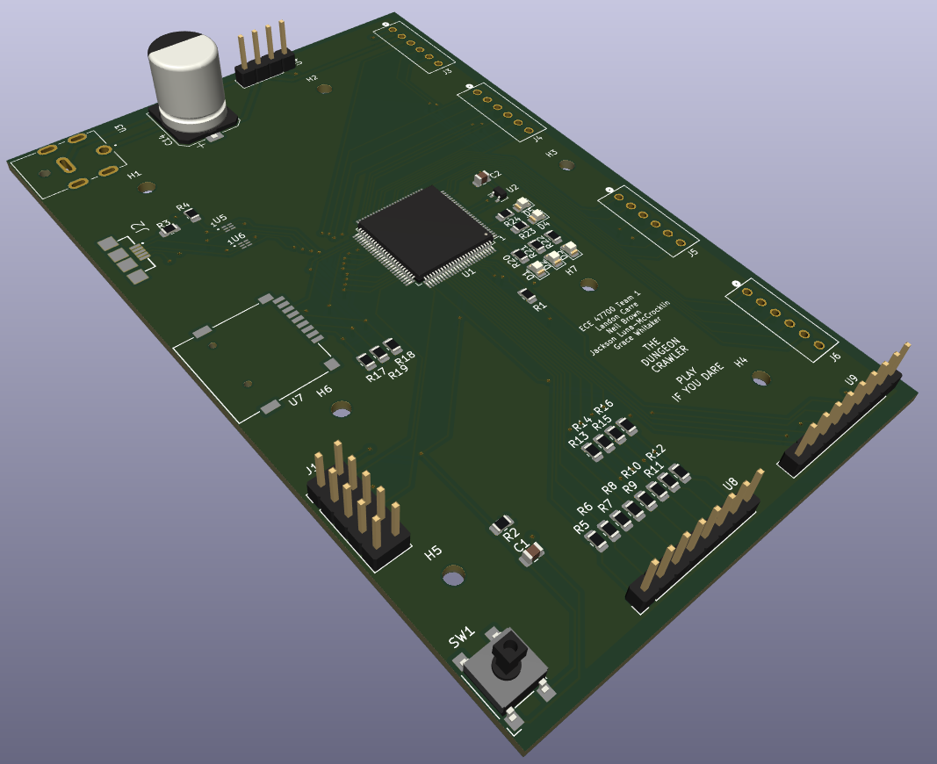
3D View
Microcontroller and Hardware
Notes:
Jackson

Slide 35
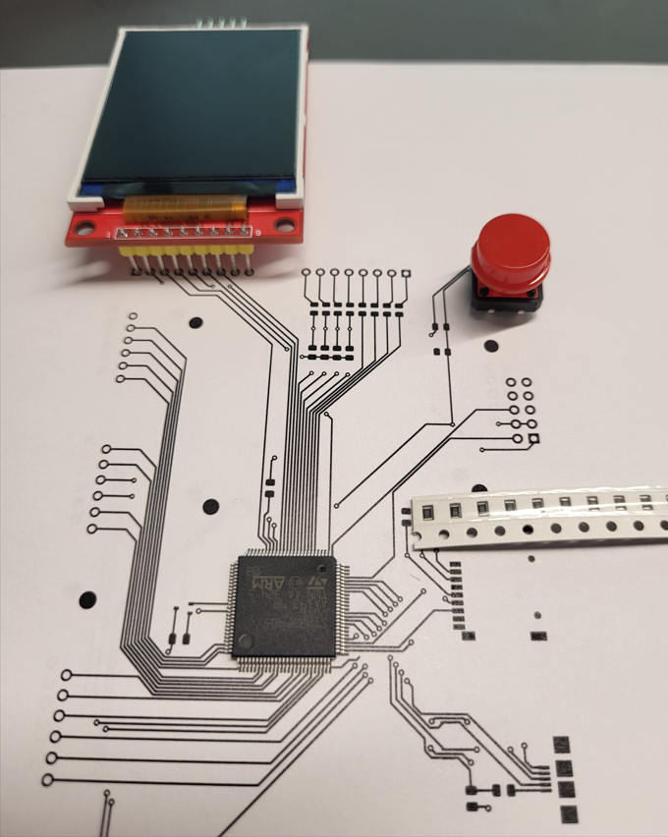
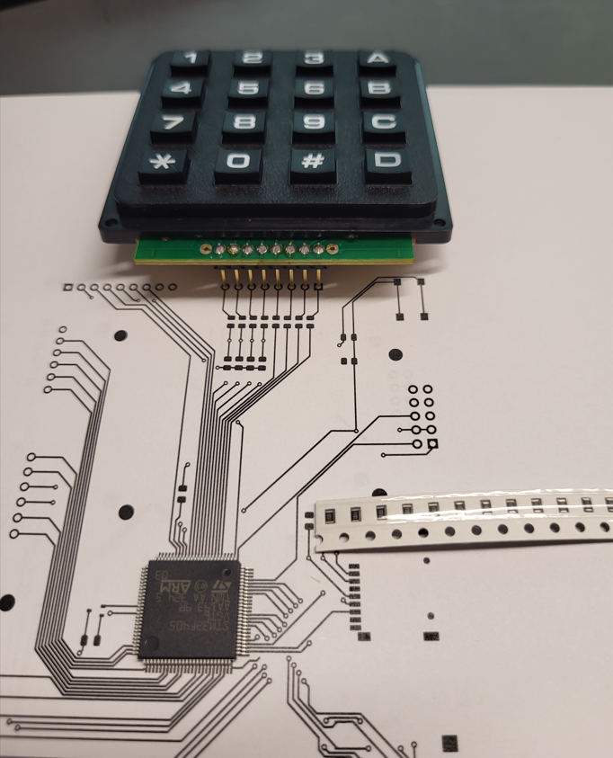
FOotprint Verification
MicroContorller and Hardware
Notes:
Jackson

Slide 36
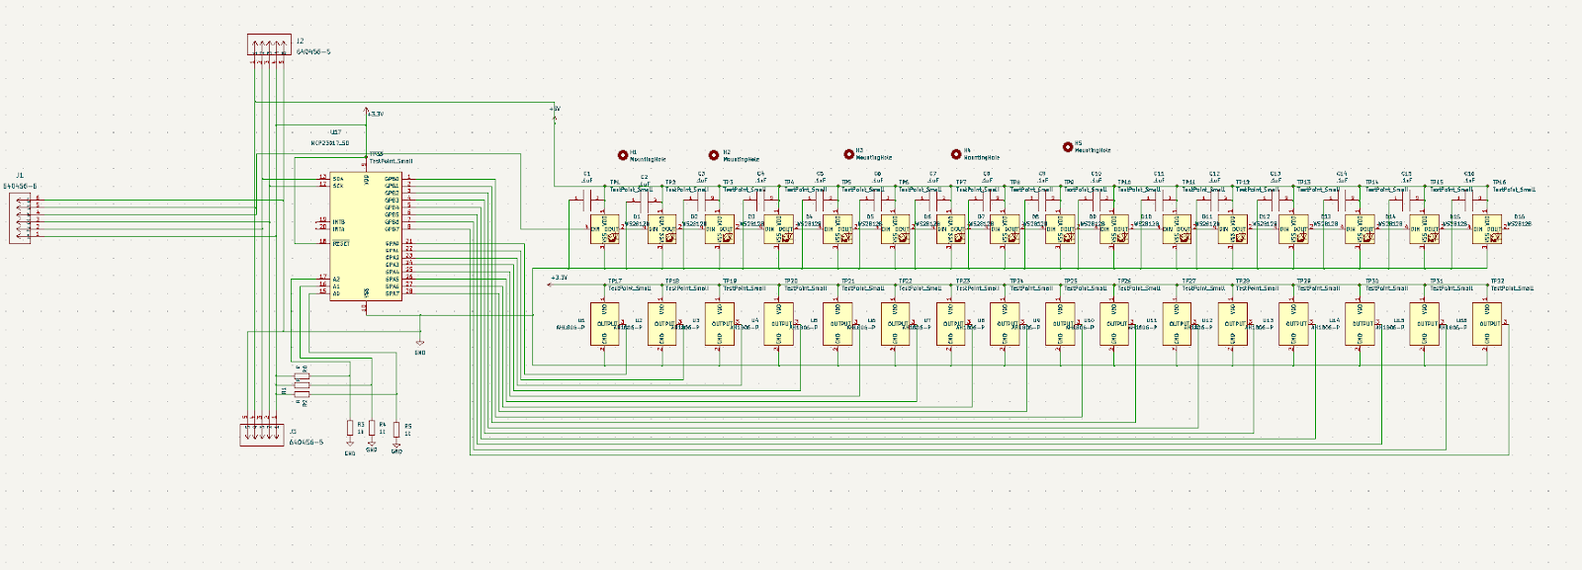
Electrical Schematic
LED and Hall effect system
Notes:
Landon

Slide 37
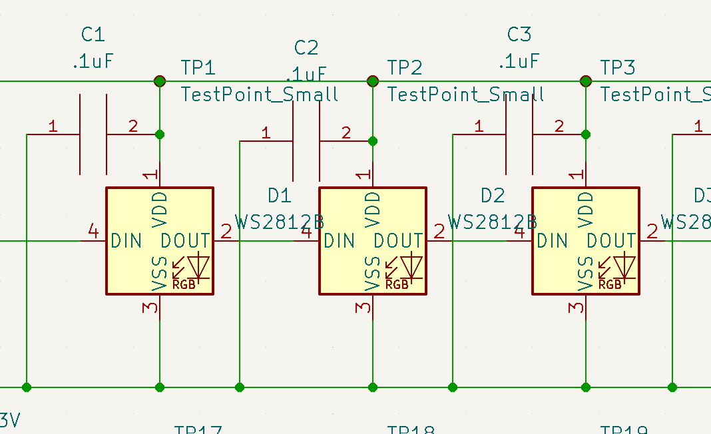
ELECTRICAL SCHEMATIC
WS2812B
Notes:
Landon

Slide 38
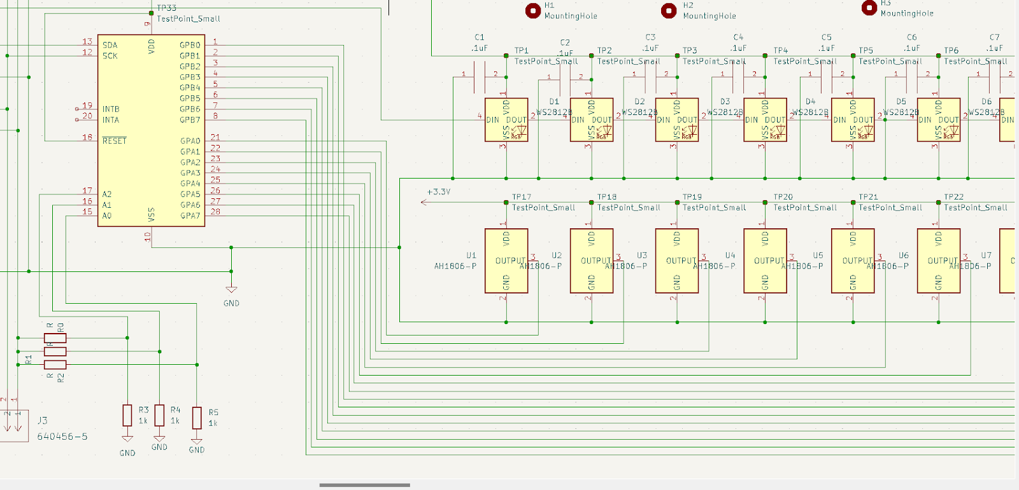
ELECTRICAL SCHEMATIC
IO Expander to Hall Effect Sensors
Notes:
Landon

Slide 39
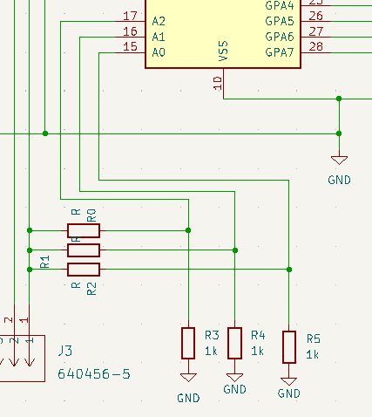
ELECTRICAL SCHEMATIC
IO EXPANDER ADDRESS PINS
Notes:
Landon

Slide 40
PCB Layout
LED and Hall effect system
Length: 450 mm
Width: 25 mm
Notes:
Landon

Slide 41
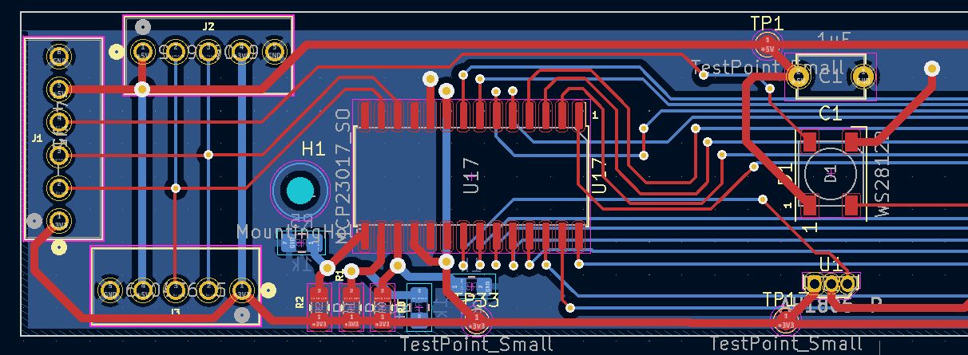
PCB Layout
Front End Connectors & IO Expander to LEDS and SENSORS
Notes:
Landon

Slide 42
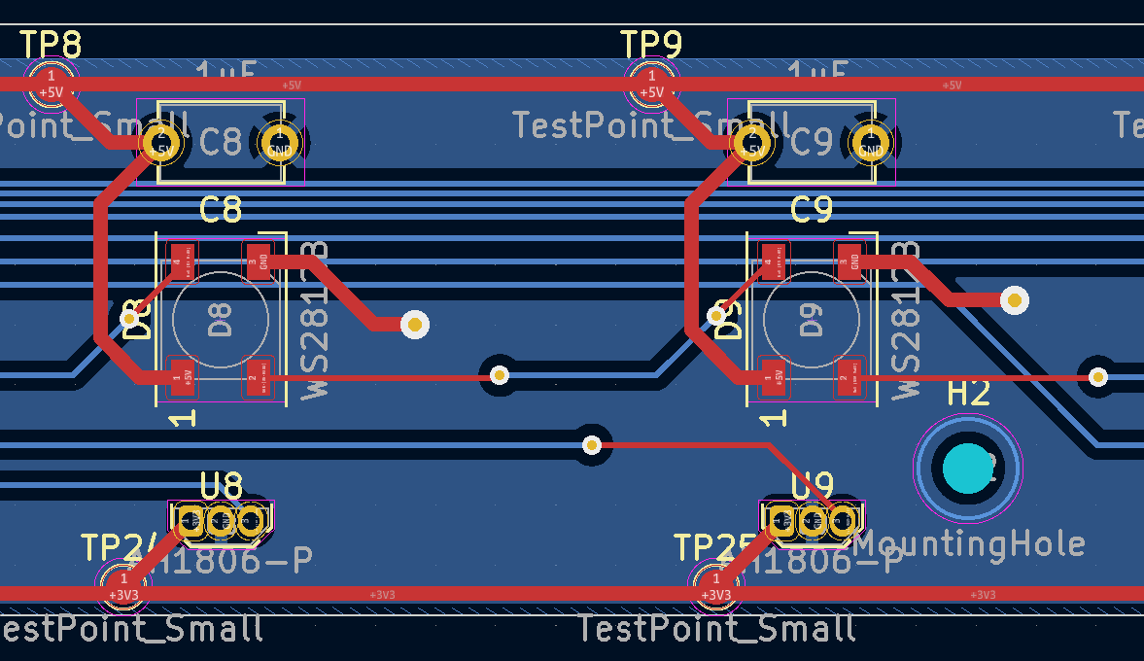
PCB Layout
WS2812B w/Decoupling capacitor
Notes:
Landon

Slide 43
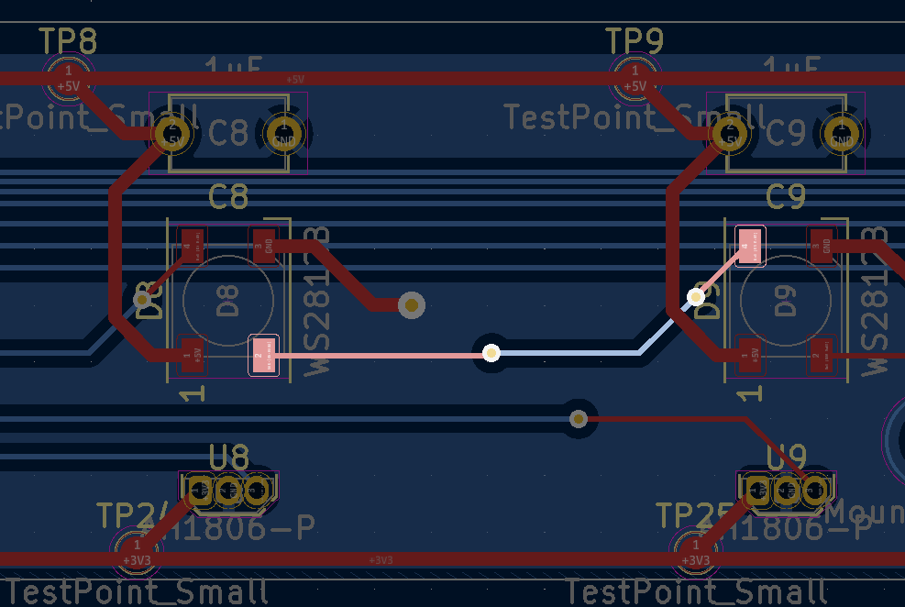
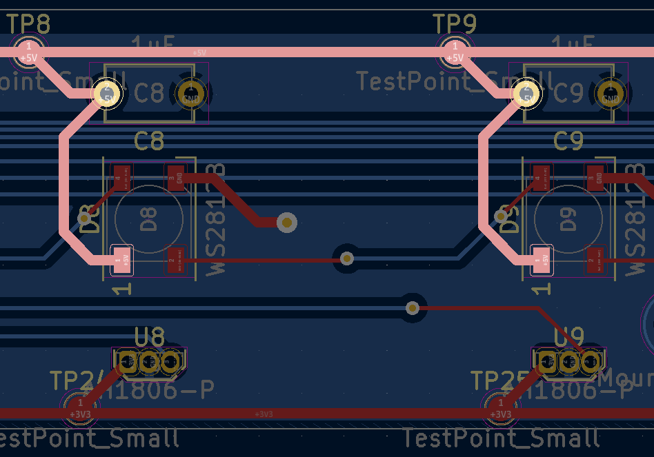
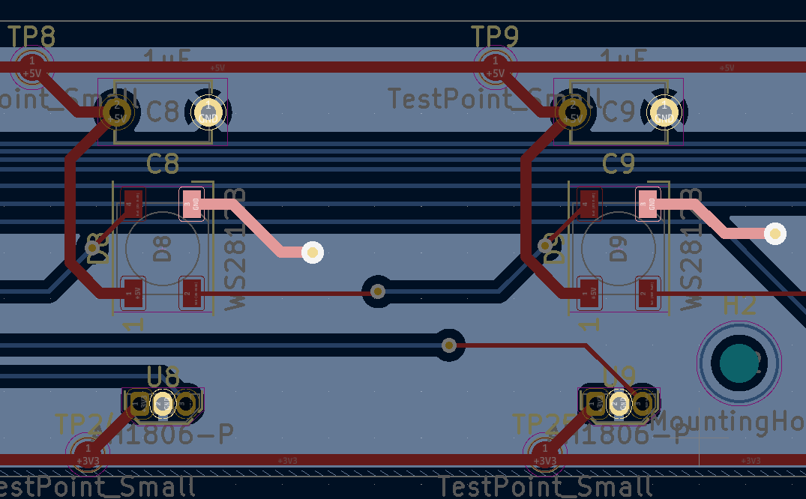
PCB Layout
WS2812B w/Decoupling capacitor
Data Line
5V Supply
GND
Notes:
Landon

Slide 44
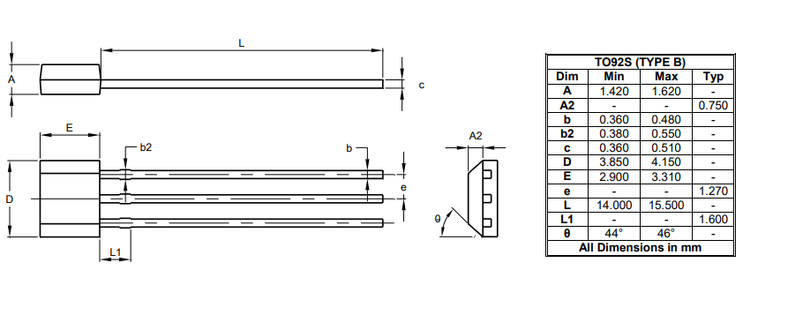
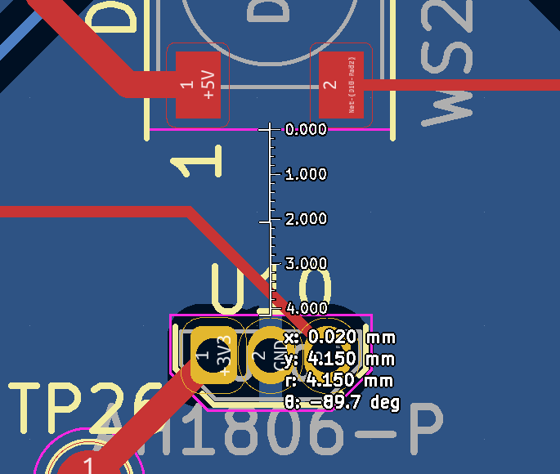
PCB Layout
HALL EFFECT Sensor placement
Hall effect spacing measurement
Notes:
Landon

Slide 45
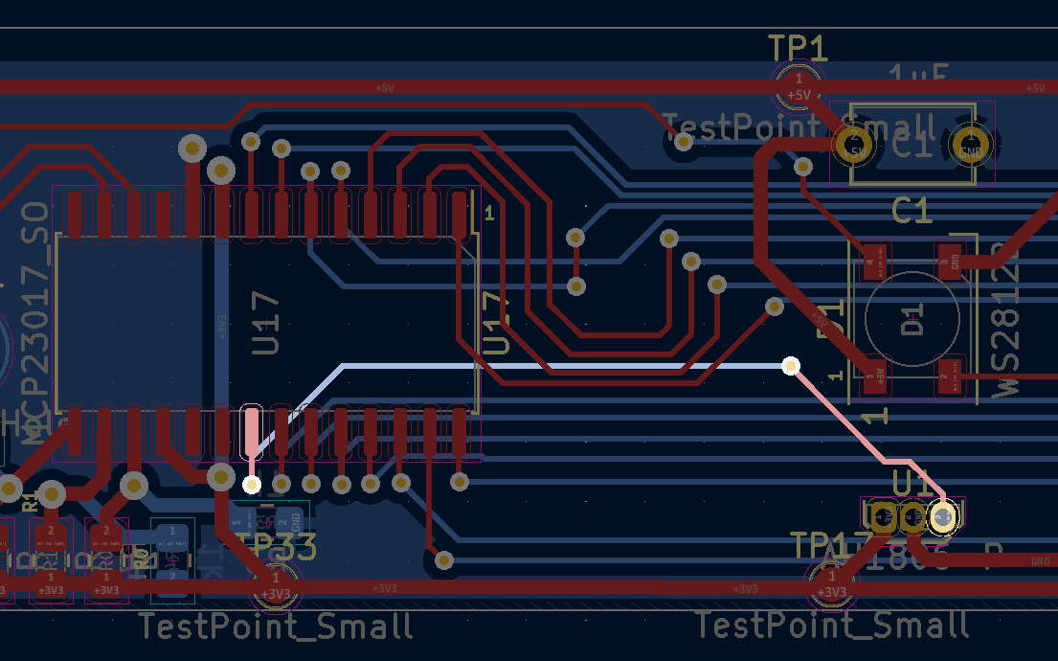
PCB Layout
IO expander to Hall effects sensors
IO Expander GPIO Port to first sensor
Notes:
Landon

Slide 46
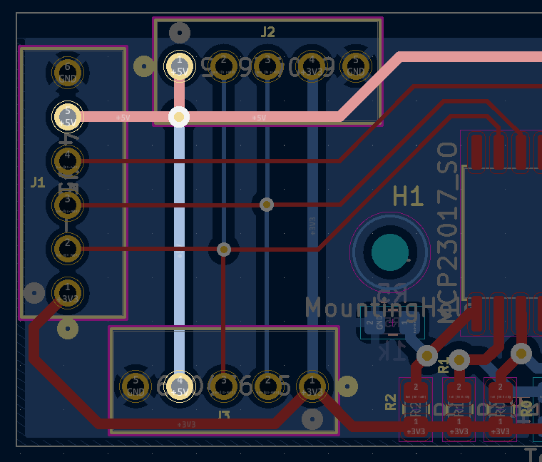


PCB Layout
16 board power system
5V Supply
GND Supply
3.3V Supply
Notes:
Landon

Slide 47


PCB Layout
I2C Control
I2C SCL
I2C SDA
Notes:
Landon

Slide 48

PCB Layout
WS2812B Data Line In
WS2812B Data Line
Notes:
Landon

Slide 49

PCB Layout
IO expander address setting
IO Expander Address Pins set with 0 Ohm resistors
Notes:
Landon

Slide 50



3D View
WS2812B & Hall effect system
Notes:
Landon

Slide 51

FOotprint Verification
WS2812B & HALL EFFECt SYSTEM
Notes:
Landon

Slide 52


Prototyping Progress
WS2812B & HALL EFFECt SYSTEM
WS2812B control using PWM - Completed
24-bit color signals to each pixel
I2C Control - Completed
Multiple addressable MCP23017 slave devices reading hall effect sensors
Notes:
Landon

Slide 53
Prototyping Progress
User INterface
USB OTG
Able to receive data from computer in a buffer to be loaded into the program
SD Card
Able to recognize MicroSD card and send and receive data using SPI
LCD
Displayed text on LCD using STM32F091
Keypad
Received keypad input using an STM32F091
Notes:
Neil

Slide 54

Software Development Status
Overview
Not Started
In Progress
Completed
Notes:
Grace [Insert Keypad]

Slide 55



Software Development Status
General I/O & Import/Storage
Notes:
Grace

Slide 56


Software Development Status
General I/O
Notes:
Grace

Slide 57
Software Development Status
Computer Application – Overview
Page 1: Map Creation
Users can select a hex type and assign it to the map
Types: Floor, Wall, Character, Enemy, and Chest
Page 2: Character Creation
Users can input their character's name, class, and stats
Export to Microcontroller
Maps and characters are translated into a text file for export
USB receives text file through USB-OTG
Notes:
Grace

Slide 58

Software Development Status
Computer Application – Main Page View
Hex Selection
Hex Type Selection
Export as Text File
16x16 Hex Map
Notes:
Grace

Slide 59


Software Development Status
Computer Application
Notes:
Grace

Slide 60
Software Development Status
Gameplay – General Overview
Initialization
Receives game input from USB communication
Map data stored array of hexagon objects
Character data stored in priority queue of character objects
Movement
Moves players efficiently using A* algorithm
Updates map after a player confirms move
Combat
Determines which character will prevail in combat based on a combination of character statistics
Remove a character from map and turn order when out of health
Notes:
Neil

Slide 61

SOFTware development status
Gameplay – general overview
Specific character types and hexagon types inherit from a main class
GameCharacter and GameMap classes contain data structures that hold their respective objects
Notes:
Neil

Slide 62



Software Development Status
Gameplay – Important Classes and Structs
Notes:
Neil

Slide 63


Software Development Status
Gameplay – Hexagon Map
Notes:
Neil

Slide 64


Software Development Status
Gameplay
Notes:
Neil

Slide 65

Project Timeline
GANTT CHart
Notes:
Neil

Slide 66
3D Printing
Questions?
Notes:
Grace: 12 Neil: 10
Landon: 20 Jackson: 22

